Slide 1
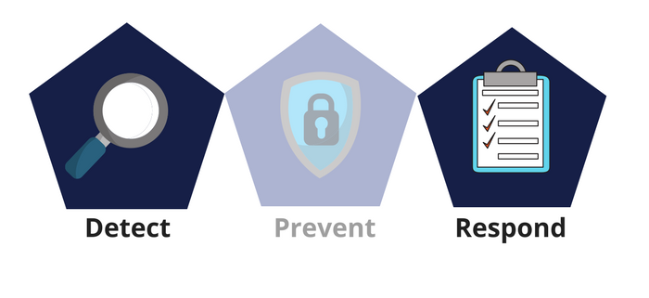



Network Security
Class IX
lab 26

Slide 2


Cyber Security
the protection of computer systems from theft or damage to their hardware, software or electronic data

Slide 3

Essential terminology
Hack value
Vulnerability
Exploit
Payload
Zero-Day attack
Daisy chaining
Doxing
Bot
Warfare
Hacking
Hacker
Ethical hacking

Slide 4
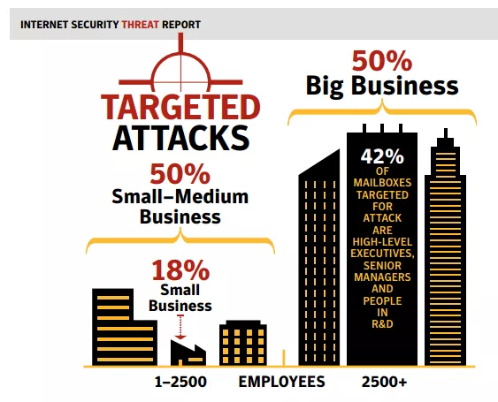
Threats and attacks
Attack = motive + method
+ vulnerability

Slide 5
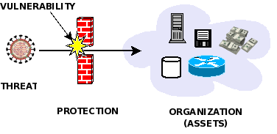
Threat Categories
Network threats
Host-based threats
Applications threats

Slide 6

Types of Hacker
Black hats
White hat
Grey hats
Suicide hackers
Script kiddies
Cyber terrorists
State sponsored hackers
Hacktivists

Slide 7
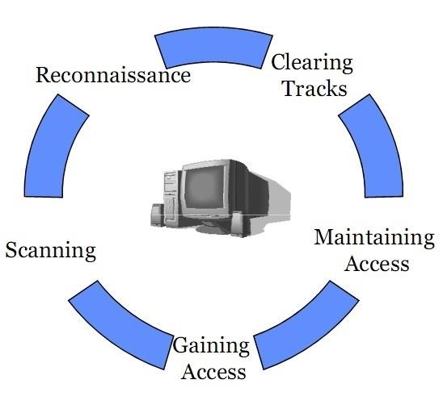
Hacking phases

Slide 8
Thank You

